Slide 1


Development of a mathematical model for predicting the inflow to the hydroelectric power station to improve the efficiency of the plant
Hugo Feidt, Eloi Jumiaux

Slide 2
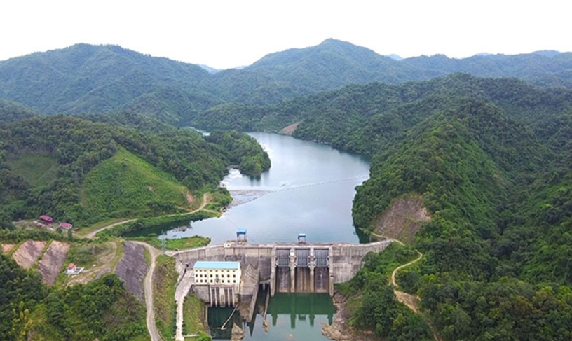
The situation
Predicting the flow of the hydropower plant of the Bac Giang river in Lang Song province (16 MW)
17 years of precipitation data measured on for stations
Previous use of ARIMA, XGBOOST and LSTM models for this problem

Slide 3
Objectives
Bibliographic study of the previous work
Attempt to improve previous model with a study of the hyperparameters
Exploring new potential models

Slide 4
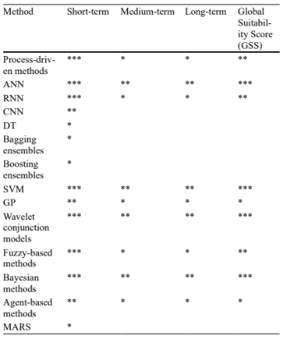
Bibliographical work
“Relevant methods have been identified with highly accurate prediction, such as ANN, SVM, wavelets and Bayesian methods.”
[1]Hamitouche, M., Molina, JL. A Review of AI Methods for the Prediction of High-Flow Extremal Hydrology. Water Resour Manage 36, 3859–3876 (2022). https://doi.org/10.1007/s11269-022-03240-y

Slide 5
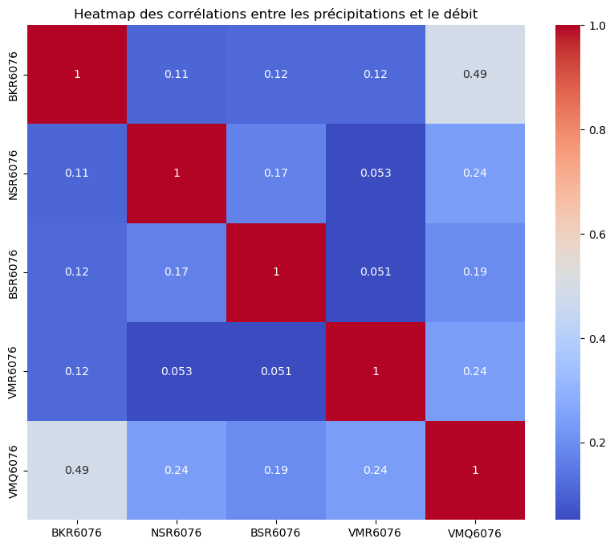
Bibliographical work
Study of the correlation between data
Combining different models to get better results
[2] “Hydro-power production capacity prediction based on machine learning regression techniques” C. Condemia,1 , D. Casillas-Pérez b,*,1 , L. Mastroeni a,1 , S. Jiménez-Fernández c, 1 , S. Salcedo-Sanz c. Knowledge based system, Volume 222, 21 June 2021, 107012

Slide 6
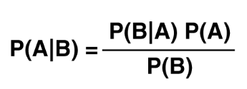
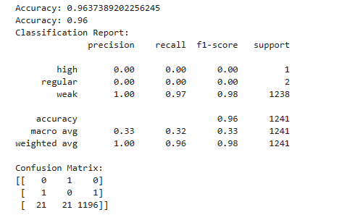
Naive bayesian model
Naive utilization: classification method
Creation of three groups: high, regular, low
Preprocessing of the datas: discretidation with the “KBinDiscretizer” function from sickit-learn
Gaussian Bayesian model: “GaussianNB”
Evaluated with accuracy, recall and f1-score

Slide 7
Naive bayesian model
Method | Accuracy | F1-score (weak) | F1-score (regular) | F1-score (high)
SMOTE | 0.47 | 0.59 | 0.15 | 0.50
pd.qcut | 0.85 | 0.93 | 0.23 | 0.19
Normalization | 0.47 | 0.59 | 0.15 | 0.50
Cross-validate | 0.85 | 0.93 | 0.23 | 0.19

Slide 8
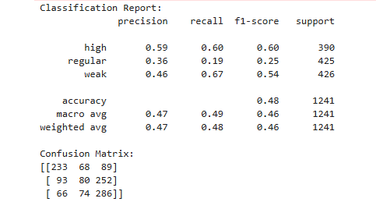
Naive bayesian model

Slide 9
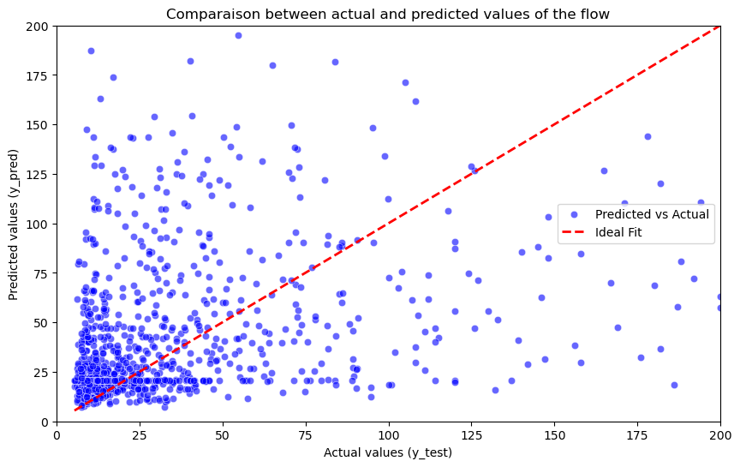
Random forest regressor
Method combining several decision trees using ensemble learning
Mean squared error (MSE) : 3868.48
Coefficient of determination (R²) : 0.23
Coefficient of correlation ( r ): 0.51
Feature importance BKR6076 : 0.51
Feature importance NSR6076 : 0.19
Feature importance BSR6076 : 0.13
Feature importance VMR6076 : 0.17

Slide 10
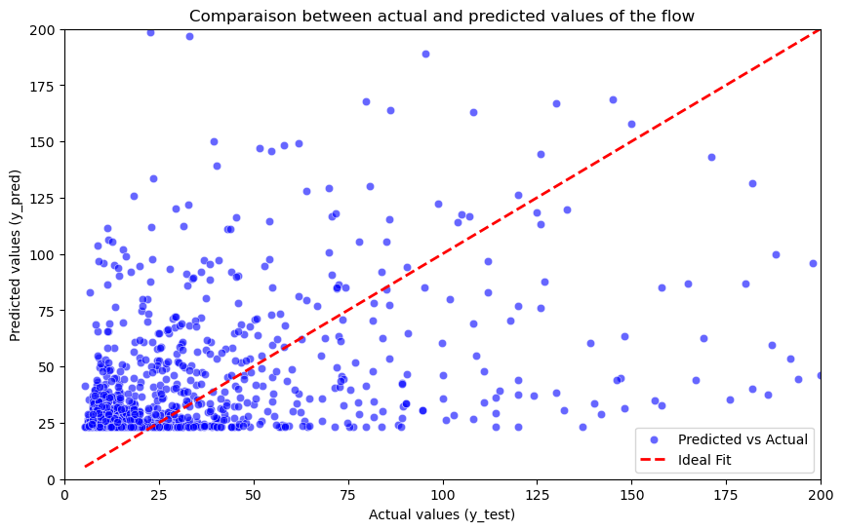
Random forest regressor
Mean squared error (MSE) : 3591.80
Coefficient of determination (R²) : 0.29
Coefficient of correlation ( r ): 0.53
BKR6076 2.859171
NSR6076 1.115784
BSR6076 0.544634
VMR6076 1.212503

Slide 11
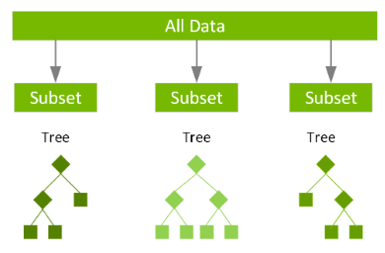
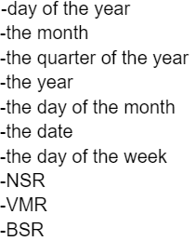
XGBoost models
Decision tree Gradient Boosting method
structure :
-1000 estimators
-early stopping rounds 500
-learning rate of 0.1
Features taken into account:

Slide 12
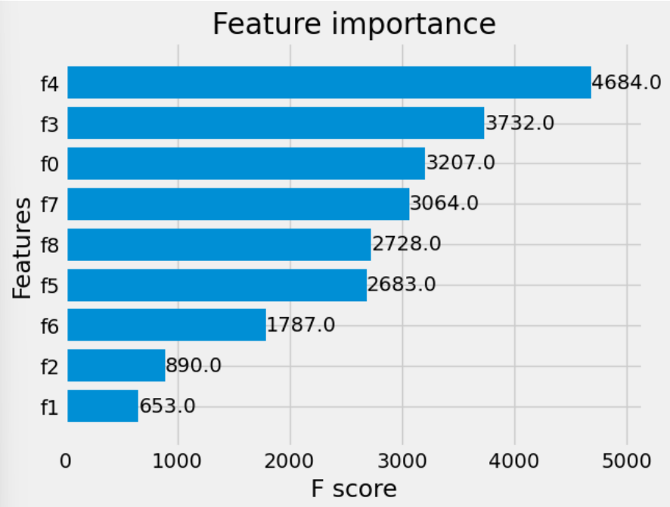
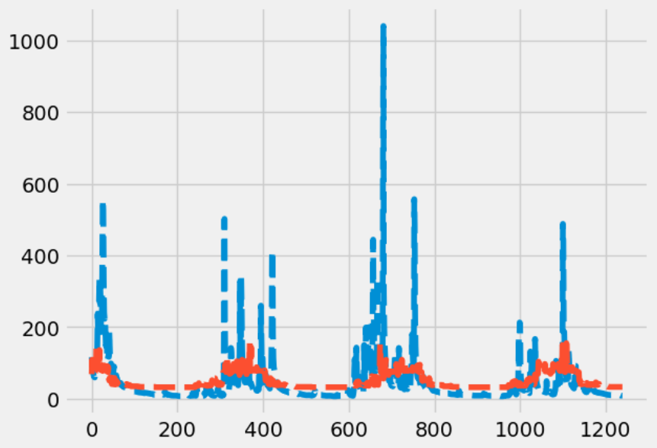
correlation coefficient=0.396
RMSE=67.469
day of the year and year most important features
-Fail to follow the inflow during rain season

Slide 13
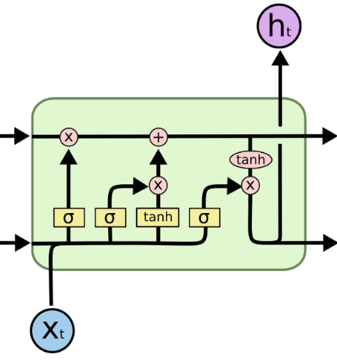
LSTM models
-Recurrent neural network
-Structure chosen:
-50 neurons on the first layer
-1 hidden layer
-Trained on 50 epochs by batch of 72

Slide 14
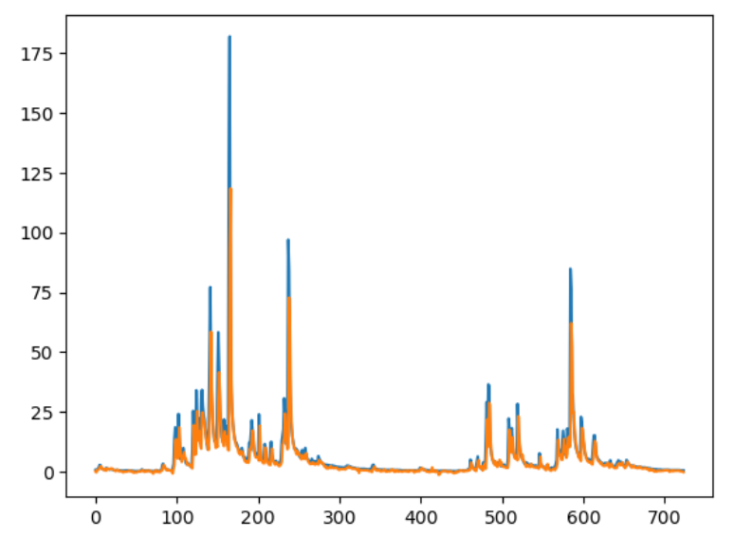
Results
0.69<Correlation coefficient<0.76
Correlation coefficient≈0.734
-Follow the real curve
- can predict sudden change in behaviour during rain season
-May need more data to be more accurate in predicting

Slide 15
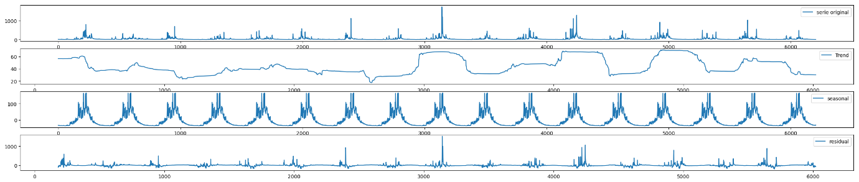
ARIMA models
AutoRegressive Integrated Moving Average
Model chosen : ARIMA[3,0,5]
Use of ACF, PACF and autoarima function

Slide 16
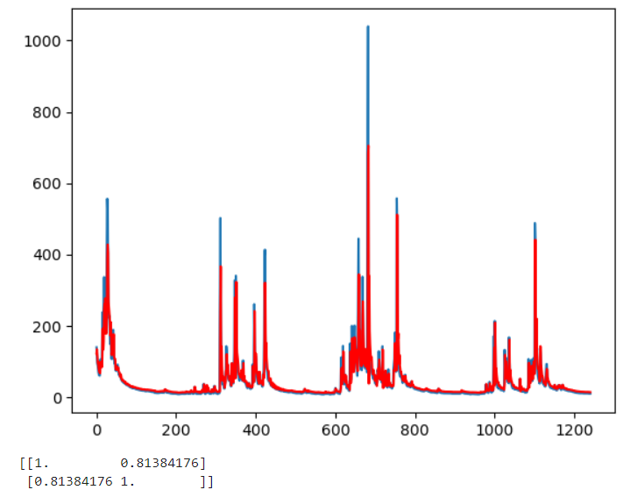
Results
Correlation coefficient=0.8138
RMSE=42.351
-Follow closely the real data
-Do not predict sudden increase follow well afterward

Slide 17
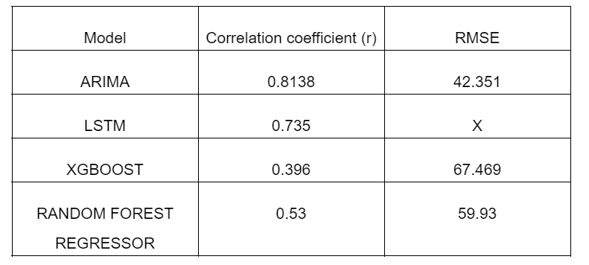
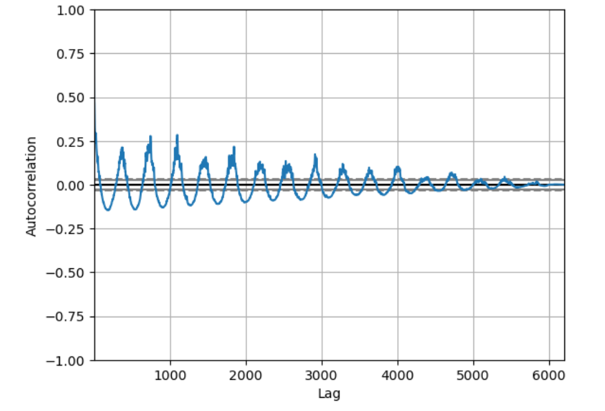
Conclusion
-Overall best : ARIMA
-Best to predict sudden increase : LSTM
-LSTM may need more data to be more accurate
Loss in correlation between recent year and furthest year
Change of the weather behaviour throughout the year
Autocorrelation function of inflow in Vinh Muc

Slide 18
Ways to improve
-Hybride model (mix between ARIMA and LSTM for example) to cover the weaknesses of each
-Collect more data
-Preprocessing the data to eliminate possible noise

