Slide 1
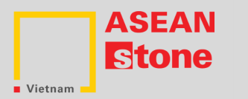
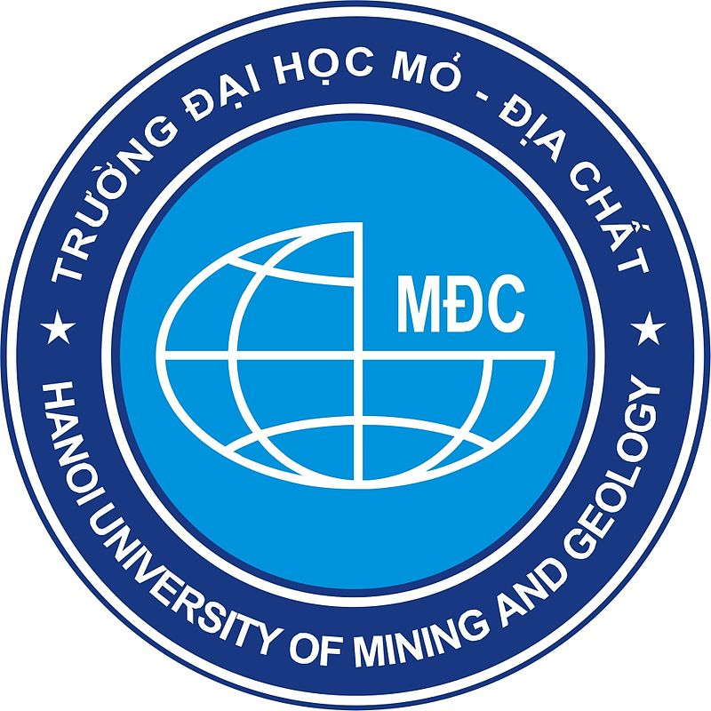
Opportunities and Challenges of the Stone Industry in Vietnam
Dr. Nga Nguyen
Hanoi University of Mining and Geology
nguyenthihoainga@humg.edu.vn

Slide 2
OUTLINE
Introduction
The stone industry and its contribution to sustainable development in Vietnam
Opportunities for the development
Challenges for the development
Conclusion

Slide 3
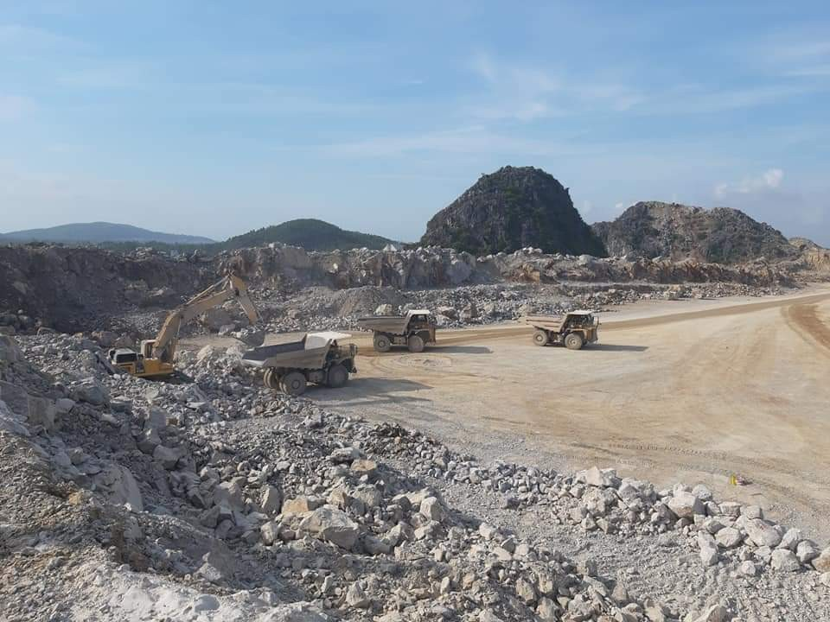
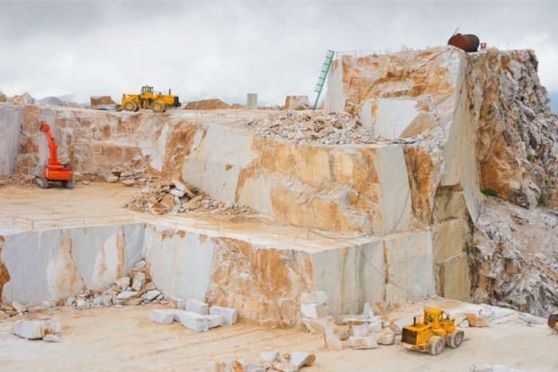
THE STONE INDUSTRY IN VIETNAM
A nationally significant industry:
  Cement production
  Construction
  Chemical industry
Mass production since the 19th century
Blooming since 1975
Nghe An
Binh Dinh

Slide 4
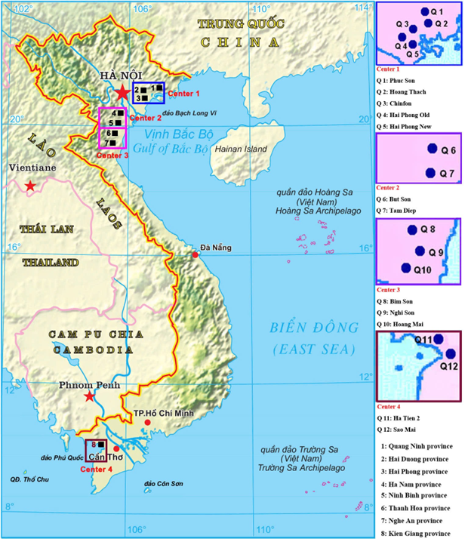
THE STONE INDUSTRY IN VIETNAM
Considerable limestone resources
Limestone is located mainly in 4 regions,
hundreds of quarries:
  Small-scale (<100.000 t/a)
  Medium-scale (100.000 - 1.000.000 t/a)
  Large-scale (> 1.000.000 t/a)
Technology:
  Drilling-blasting method
  Loading by hydraulic excavator and wheel loader
  hauling by truck.
Non-blasting methods are being interested

Slide 5
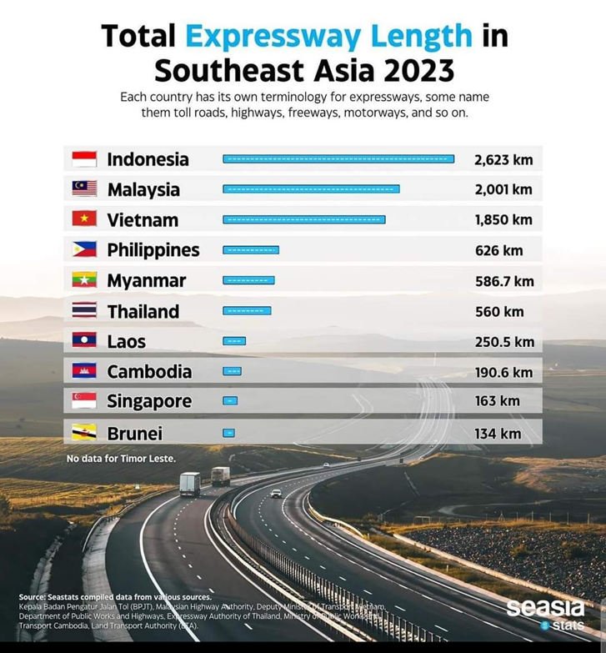
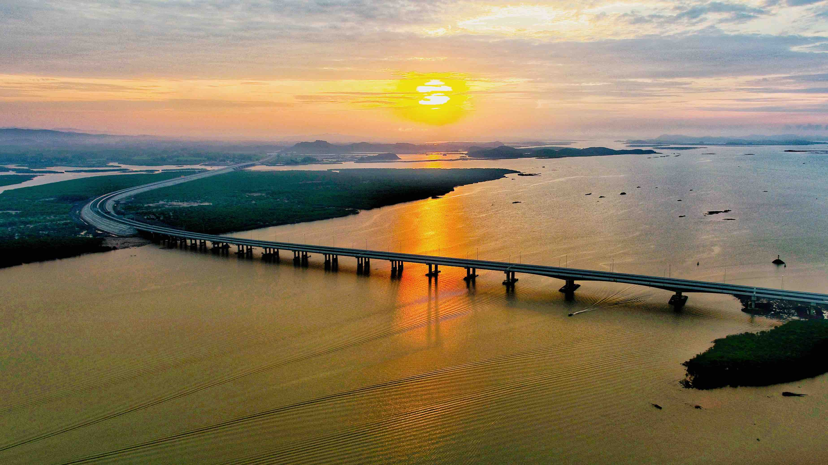
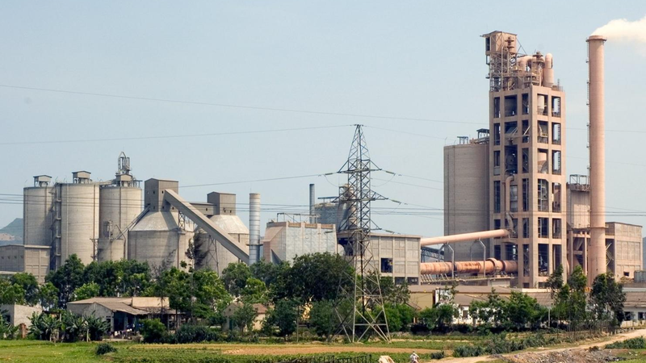
THE STONE INDUSTRY
AND ITS CONTRIBUTION
Contribution to the GDP:
  Stable development growth
  Construction materials: sandstone, marble, granite, etc.
  Cement production
  Export: marble, processed stones
Cement Hoang Mai
Highway Van Don – Mong Cai

Slide 6
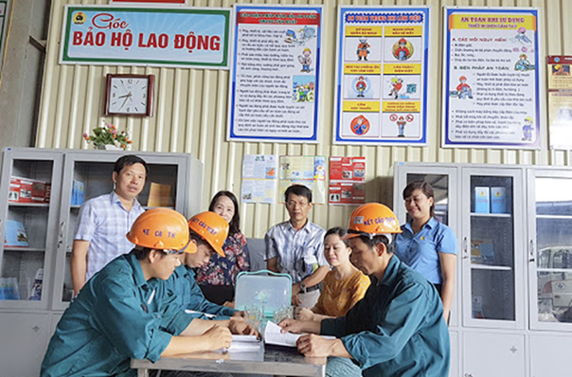
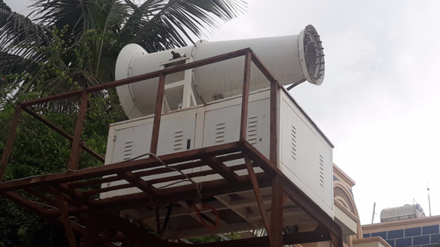
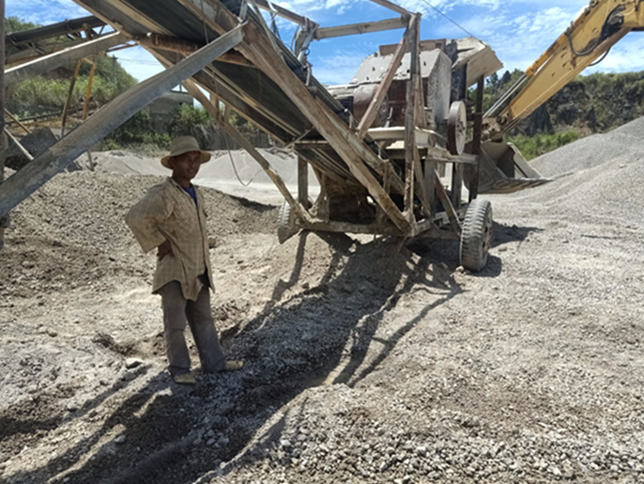
THE STONE INDUSTRY
AND ITS CONTRIBUTION
Contribution to society:
  Workers and staff
  Induced labor force
  Environmental protection
  CSR programs

Slide 7
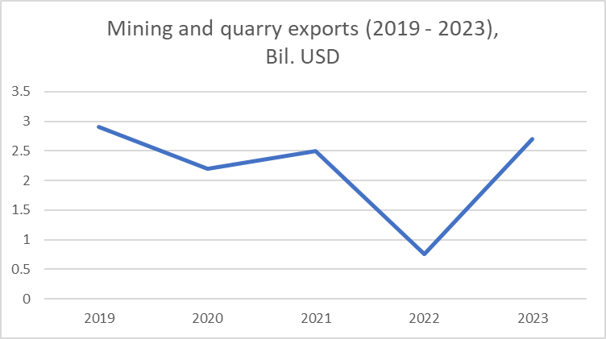
OPPORTUNITIES
Supports of Government:
  Boosting exports
  Concrete strategic plans for infrastructure development
  Public investment
  Incentives
  Priorities in advanced technology in exploration, processing, and utilizing resources
Source: Statistical Yearbook of Vietnam, 2023

Slide 8
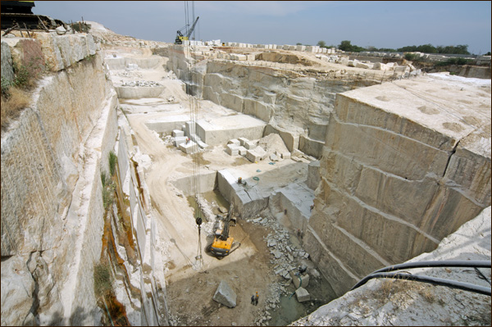
OPPORTUNITIES
Rich high-quality natural stone resources:
  Reserves:
    Stones for cement production: 31.4 bil. tons
    Marble, stone art: 2.2 bil. m³
  Resources available to exploration:
    Stones for cement production:
      To 2030: 1.7 bil. tons
      To 2050: 4.8 bil. Tons
    Marble, stone art: capacity of 2.3 mil. m³/year
  Source:
  Decision 1626/QD-TTg of the Prime Minister, dated Dec.15, 2023: Approval for the planning of exploration, extraction, processing, and use of minerals as building materials for 2021-2030, outlook to 2050

Slide 9
OPPORTUNITIES
High and accelerated market demand
Source: Ministry of Construction

Slide 10
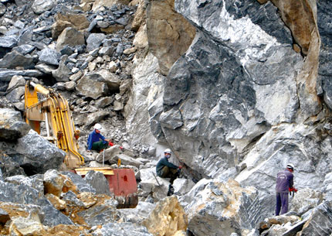
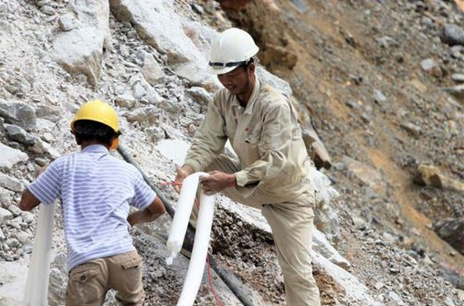
OPPORTUNITIES
Competitive labor costs
Workers in quarry mines in the North of Vietnam

Slide 11
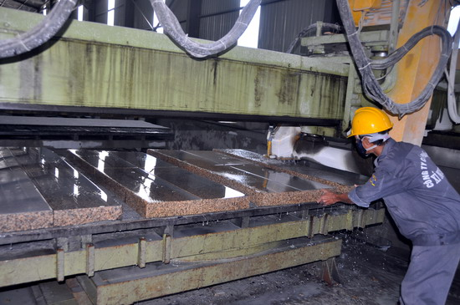
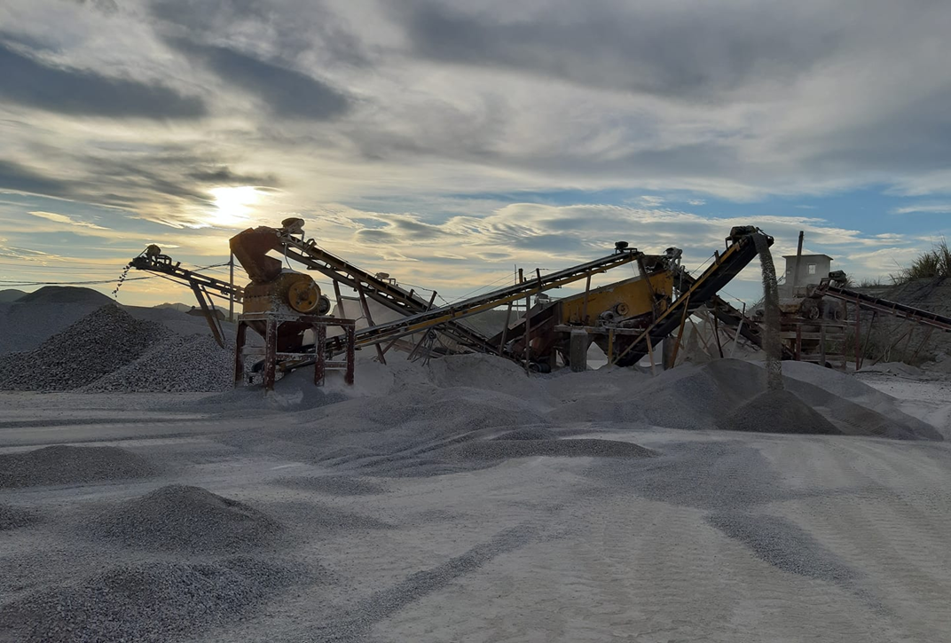
OPPORTUNITIES
Development of processed stone products with advanced technology
Stone processing in Hanam
Nghe An, 2020

Slide 12
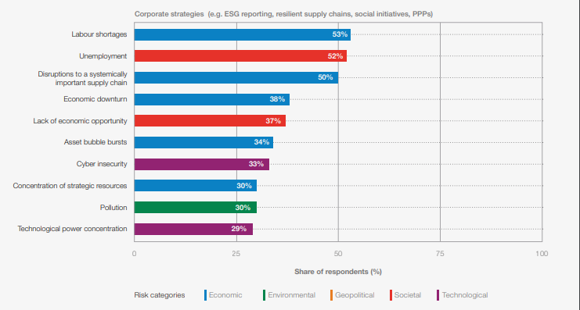
CHALLENGES
Top global risks addressed by Corporate strategies
World Economic Forum
Global Risks Perception Survey 2023-2024

Slide 13
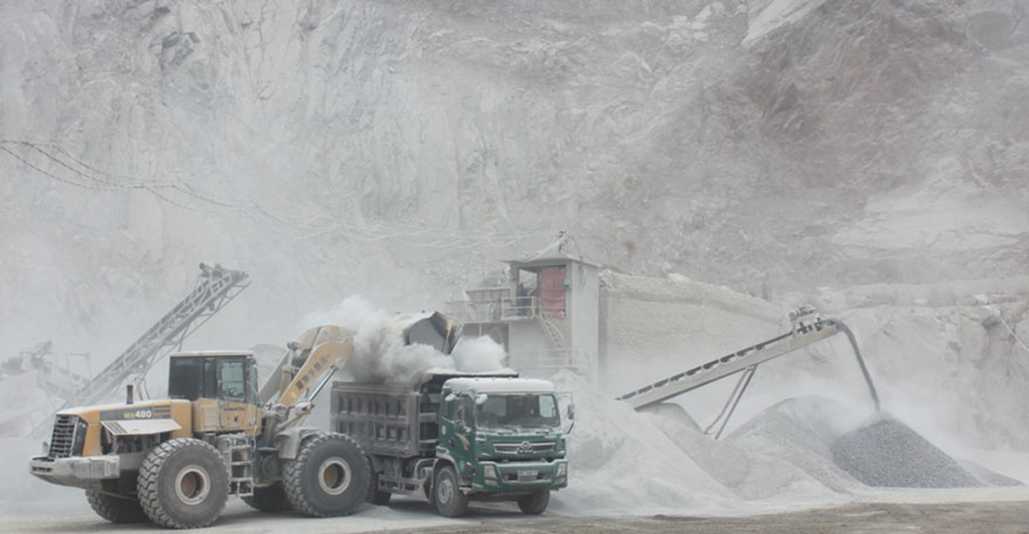
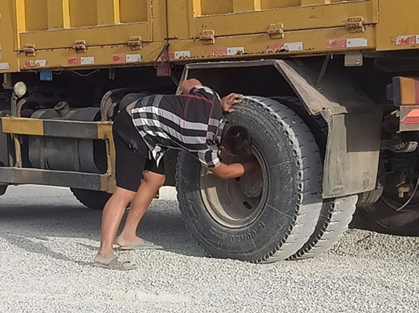
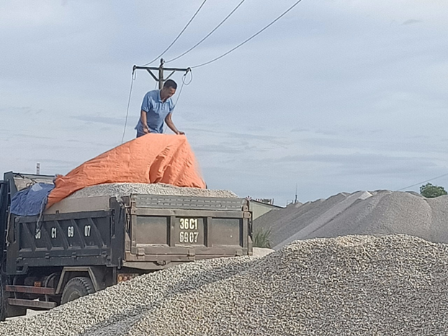
CHALLENGES
ESG and Social acceptance:
  Labor force qualification and skills
  Health, safety and wellbeing
  Environment
Nghe An 2020
Nghe An 2020

Slide 14
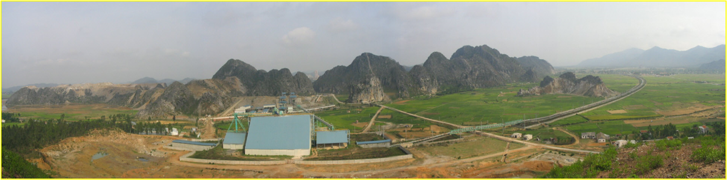
CHALLENGES
Resource depletion and wasted consumption
Notes:
there is a risk of resource depletion if quarrying is not managed sustainably. Over-exploitation of quarries without adequate replenishment or alternative resource exploration could threaten the long-term viability of the industry.

Slide 15
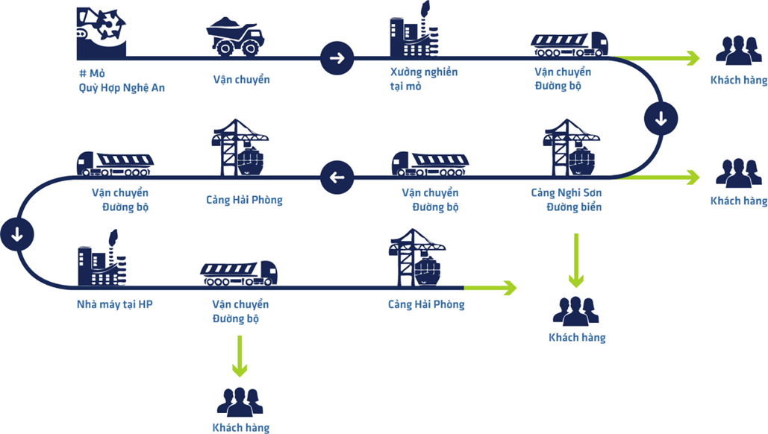

CHALLENGES
New and strictly legal requirements

Slide 16
CHALLENGES
Market:
  Global competition:
    Other stone producers in Asia, Latin America, and Europe
    Volume, quality, and higher global standards
  Slow recovery of the real estate market
  Fragmentation:
    Many SMEs
    lack of standardization
    low investment in R&D
    Inefficiencies in production
Notes:
Competing with larger, more established stone producers like China and India. The need to improve technological innovation and processing capacity to meet global standards.
The stone industry in Vietnam is highly fragmented, with many small- and medium-sized enterprises (SMEs) dominating the market. While this allows for flexibility, it also means there is a lack of standardization, low investment in research and development, and inefficiencies in production processes. Many companies may struggle to meet international standards, hindering their ability to compete globally.

Slide 17
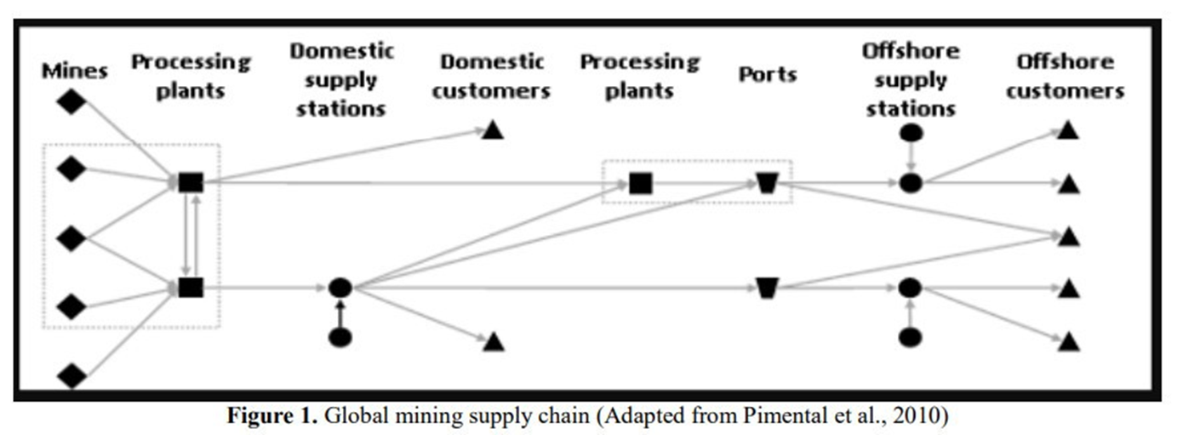
CHALLENGES
Market:
  Supply - demand imbalance
  Consumers’ finance
  Supply chain disruption
Notes:
Competing with larger, more established stone producers like China and India. The need to improve technological innovation and processing capacity to meet global standards.
The stone industry in Vietnam is highly fragmented, with many small- and medium-sized enterprises (SMEs) dominating the market. While this allows for flexibility, it also means there is a lack of standardization, low investment in research and development, and inefficiencies in production processes. Many companies may struggle to meet international standards, hindering their ability to compete globally.

Slide 18
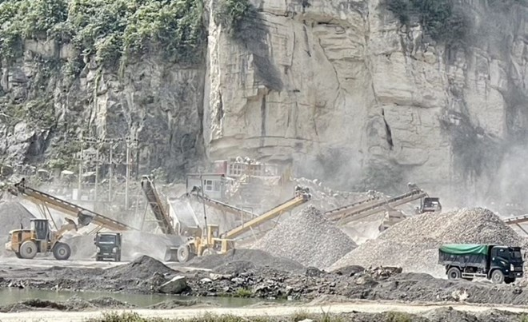
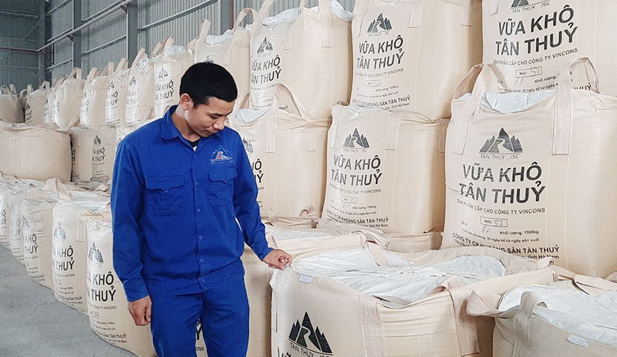
CHALLENGES
Technology:
Ninh Binh
Dry mortar production

Slide 19
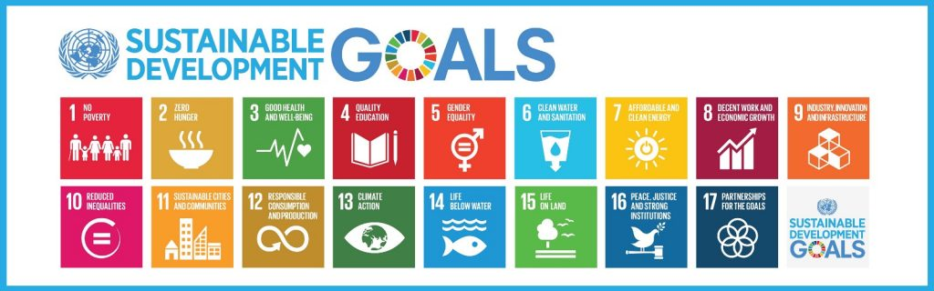
POST MINING
What can we do
MINERALS RESOURCES FOR THE SUSTAINABLE DEVELOPMENT
Exploration
Mining, processing, using
Post mining

Slide 20
Thank you for listening

Slide 21
Opportunities and Challenges of the Stone Industry in Vietnam
Dr. Nga Nguyen
Hanoi University of Mining and Geology
nguyenthihoainga@humg.edu.vn

