Slide 1

Toi Trung Tran, Thanh-Hai Pham*, Thuat Tien Phung
Department of Mineral processing, Faculty of Mining, Hanoi University of Mining and Geology
Research on hydrometallurgy technology to recover copper in fine solid waste slurry from the electronic board manufacturing stage of Samsung factory, Thainguyen

Slide 2

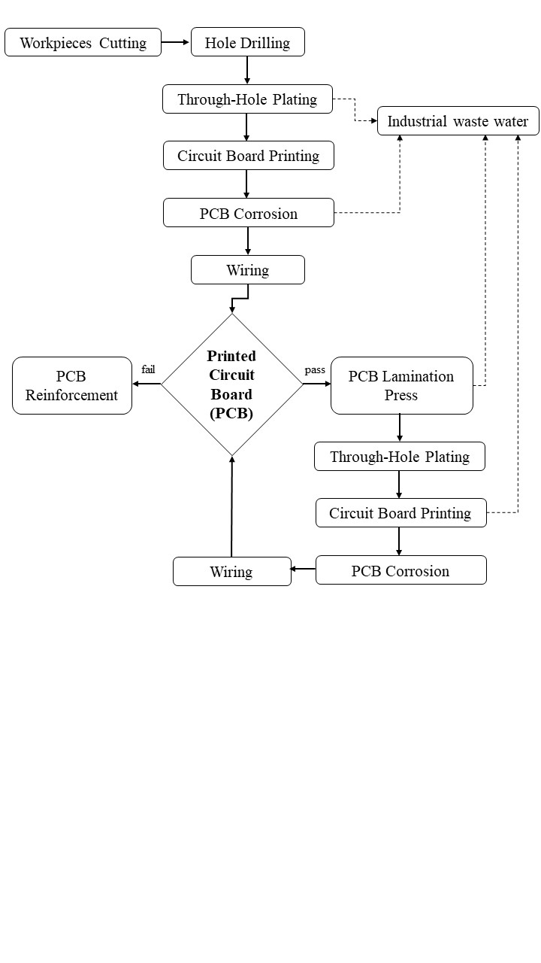
Thanh-Hai Pham| Research on hydrometallurgy technology to recover copper in fine solid waste slurry
from the electronic board manufacturing stage of Samsung factory, Thainguyen
Diagram for printed circuit board manufacturing process

Slide 3
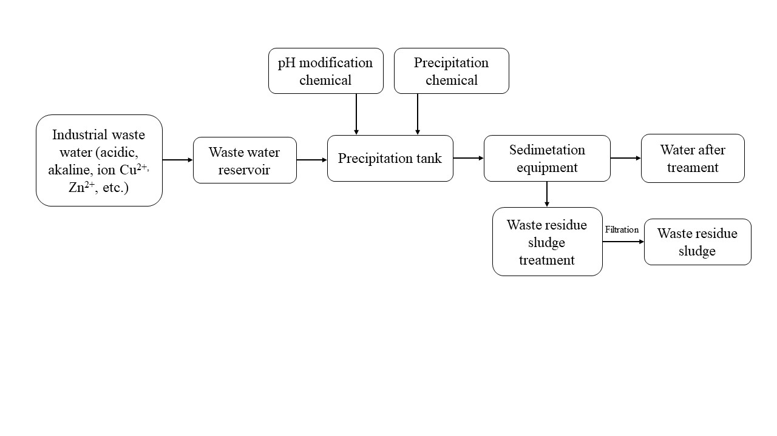
Thanh-Hai Pham| Research on hydrometallurgy technology to recover copper in fine solid waste slurry
from the electronic board manufacturing stage of Samsung factory, Thainguyen
Diagram of industrial wastewater treatment by precipitation method

Slide 4
Thanh-Hai Pham| Research on hydrometallurgy technology to recover copper in fine solid waste slurry
from the electronic board manufacturing stage of Samsung factory, Thainguyen
High temperature treatment
Thermal treatment by plasma
Pyrometallurgy
Hydro metallurgy
Waste sludge treatment in order to recover the valuable elements
Waste sludge treatment methods

Slide 5
Thanh-Hai Pham| Research on hydrometallurgy technology to recover copper in fine solid waste slurry
from the electronic board manufacturing stage of Samsung factory, Thainguyen
Chemical composition of waste sludge sample
No. | Analytical criteria | Unit | Grade content | No. | Analytical criteria | Unit | Grade content
1 | Al₂O₃ | % | 0.35 | 19 | Cu | ppm | 240,576.8
2 | CaO |  | 14.35 | 20 | Ga |  | < 10
3 | Fe₂O₃ |  | 21.28 | 21 | Ge |  | < 20
4 | K₂O |  | 0.01 | 22 | La |  | < 5
5 | MgO |  | 1.91 | 23 | Li |  | < 5
6 | MnO |  | 0.25 | 24 | Mo |  | < 5
7 | P₂O₅ |  | 0.04 | 25 | Nb |  | < 5
8 | TiO₂ |  | 0.31 | 26 | Ni |  | 3,916.6
9 | Ag | ppm | < 2 | 27 | Pb |  | 139.6
10 | As |  | < 20 | 28 | Sb |  | < 10
11 | B |  | < 10 | 29 | Sc |  | < 5
12 | Ba |  | 489.1 | 30 | Sn |  | < 10
13 | Be |  | < 5 | 31 | Sr |  | 226.1
14 | Bi |  | < 10 | 32 | Ta |  | 32.7
15 | Cd |  | < 2 | 33 | V |  | 5.1
16 | Ce |  | < 5 | 34 | W |  | < 20
17 | Co |  | 121.9 | 35 | Y |  | 11.0
18 | Cr |  | 39.2 | 36 | Zn |  | 1,495.3

Slide 6
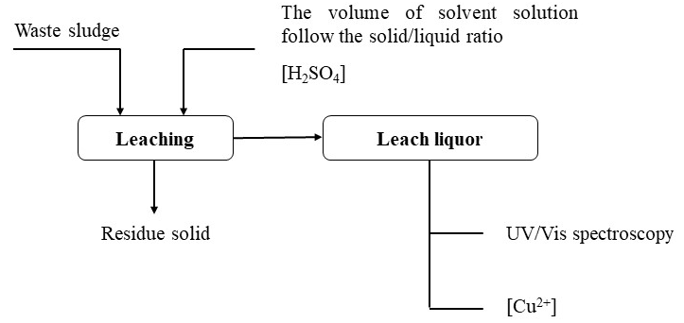
Stage 1. Leaching process
Thanh-Hai Pham| Research on hydrometallurgy technology to recover copper in fine solid waste slurry
from the electronic board manufacturing stage of Samsung factory, Thainguyen
Flowchart of copper leaching experiment from sample

Slide 7
Thanh-Hai Pham| Research on hydrometallurgy technology to recover copper in fine solid waste slurry
from the electronic board manufacturing stage of Samsung factory, Thainguyen
The effect of the acid concentration on the Cu leaching efficiency and Cu grade in residue
The effect of the solid/liquid ratio on the Cu leaching efficiency and Cu grade in residue

Slide 8
Thanh-Hai Pham| Research on hydrometallurgy technology to recover copper in fine solid waste slurry
from the electronic board manufacturing stage of Samsung factory, Thainguyen
The effect of the leaching time on the Cu leaching efficiency and Cu grade in residue
The effect of the leaching temperature on the Cu leaching efficiency and Cu grade in residue

Slide 9
Thanh-Hai Pham| Research on hydrometallurgy technology to recover copper in fine solid waste slurry
from the electronic board manufacturing stage of Samsung factory, Thainguyen
Chemical composition of pregnant solution after leaching in the optimal conditions
No. | Analytical criteria | Unit | Grade content | No. | Analytical criteria | Unit | Grade content
1 | Al | mg/l | 70.83 | 19 | Cu | mg/l | 29,723.6
2 | Ca |  | 586.49 | 20 | Ga |  | < 0.01
3 | Fe |  | 4,284.84 | 21 | Ge |  | < 0.01
4 | K |  | 19.39 | 22 | La |  | < 0.01
5 | Mg |  | 1,247.98 | 23 | Li |  | 0.1
6 | Mn |  | 215.36 | 24 | Mo |  | 0.4
7 | P |  | 10.92 | 25 | Nb |  | < 0.01
8 | Ti |  | 34.44 | 26 | Ni |  | 251.3
9 | Ag |  | 1.9 | 27 | Pb |  | < 0.01
10 | As |  | 2.2 | 28 | Sb |  | < 0.01
11 | B |  | < 0.01 | 29 | Sc |  | 0.2
12 | Ba |  | 3 | 30 | Sn |  | < 0.01
13 | Be |  | < 0.01 | 31 | Sr |  | 4.8
14 | Bi |  | < 0.01 | 32 | Ta |  | < 0.01
15 | Cd |  | < 0.01 | 33 | V |  | 0.5
16 | Ce |  | < 0.01 | 34 | W |  | < 0.01
17 | Co |  | 5.8 | 35 | Y |  | 0.2
18 | Cr |  | 1.6 | 36 | Zn |  | 35.1

Slide 10
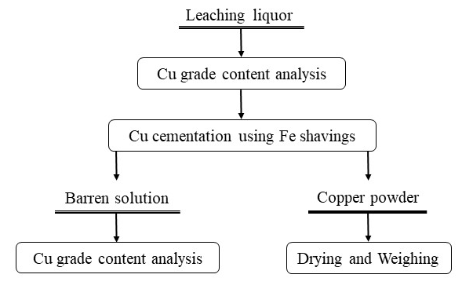
Stage 2. Copper cementation
Thanh-Hai Pham| Research on hydrometallurgy technology to recover copper in fine solid waste slurry
from the electronic board manufacturing stage of Samsung factory, Thainguyen
Flowchart for copper cementation by iron shavings

Slide 11
Thanh-Hai Pham| Research on hydrometallurgy technology to recover copper in fine solid waste slurry
from the electronic board manufacturing stage of Samsung factory, Thainguyen
The effect of the cementation time to the copper cementation efficiency and the amount Cu²⁺ in barren solution
The effect of the amount iron shavings to the copper cementation efficiency and the amount Cu²⁺ in barren solution

Slide 12
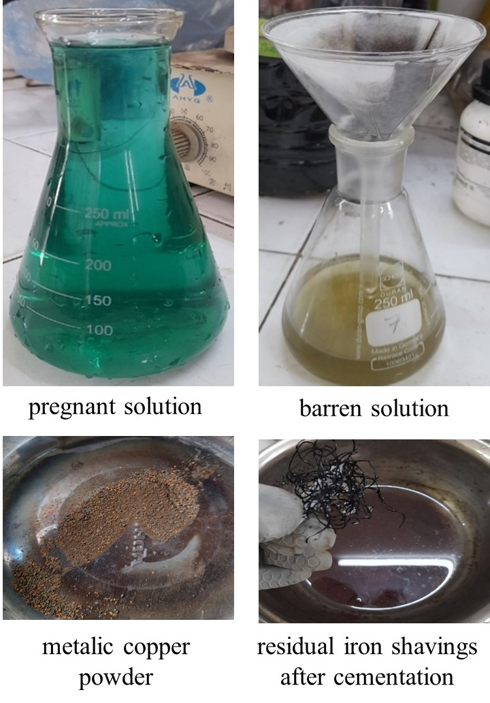
Thanh-Hai Pham| Research on hydrometallurgy technology to recover copper in fine solid waste slurry
from the electronic board manufacturing stage of Samsung factory, Thainguyen
The effect of cementation temperature to the copper cementation efficiency and the amount Cu²⁺ in barren solution

Slide 13
Thanh-Hai Pham| Research on hydrometallurgy technology to recover copper in fine solid waste slurry
from the electronic board manufacturing stage of Samsung factory, Thainguyen
Chemical composition of solution after cementation in optimal condition
No. | Analytical criteria | Unit | Grade content | No. | Analytical criteria | Unit | Grade content
1 | Al | mg/l | 57.47 | 19 | Cu | mg/l | 27.5
2 | Ca |  | 640.4 | 20 | Ga |  | < 0.01
3 | Fe |  | 21,389.87 | 21 | Ge |  | < 0.01
4 | K |  | 3.05 | 22 | La |  | < 0.01
5 | Mg |  | 1,130.36 | 23 | Li |  | 0.1
6 | Mn |  | 343.82 | 24 | Mo |  | 0.7
7 | P |  | 74.3 | 25 | Nb |  | < 0.01
8 | Ti |  | 6.07 | 26 | Ni |  | 287.7
9 | Ag |  | < 0.01 | 27 | Pb |  | 23.8
10 | As |  | 1.9 | 28 | Sb |  | < 0.01
11 | B |  | < 0.01 | 29 | Sc |  | < 0.01
12 | Ba |  | 1.4 | 30 | Sn |  | < 0.01
13 | Be |  | < 0.01 | 31 | Sr |  | 5.3
14 | Bi |  | < 0.01 | 32 | Ta |  | < 0.01
15 | Cd |  | 0.6 | 33 | V |  | 1.9
16 | Ce |  | 0.2 | 34 | W |  | 1.7
17 | Co |  | 13.4 | 35 | Y |  | 0.3
18 | Cr |  | 12.6 | 36 | Zn |  | 46.5

Slide 14
Thanh-Hai Pham| Research on hydrometallurgy technology to recover copper in fine solid waste slurry
from the electronic board manufacturing stage of Samsung factory, Thainguyen
Samples
Waste sludge from Samsung PCBs production factory, Thai Nguyen;
For the leaching process
The H₂SO₄ concentration: 1.0 mol/l; leaching time: 60 minutes, the S/L ratio:1/8; continuous stirring: ~180 rpm at room temperature;
The result: leaching efficiency:98%, the copper grade content in pregnant solution: 29.723 g/l.
Has fine particle size (100% particles passing 0.074 mm) and a copper grade content of 24.05 %.

Slide 15
Thanh-Hai Pham| Research on hydrometallurgy technology to recover copper in fine solid waste slurry
from the electronic board manufacturing stage of Samsung factory, Thainguyen
Further works
Necessary to research iron reduction methods to obtain copper powder products with high purity;
Precipitation of over 99% copper metal from the pregnant solution.
For the successive cementation process
The amount of iron shavings/copper: 1.5; stirring continuously: 60 minutes;
The barren solution after cementation contains a high amount of iron ions (21.39%), so it needs to be reduced before being recirculated for the leaching process.

Slide 16
Thank you for your attention!
Contact:
Dr. Thanh-Hai Pham (Mr.)
Department of Mineral processing, Hanoi University of Mining and Geology
Address: No.18, Vien Str., Ducthang ward, Bactuliem dist., Hanoi, Vietnam
Email: phamthanhhai@humg.edu.vn
Tel: (+84) 788 268 258

