Slide 1
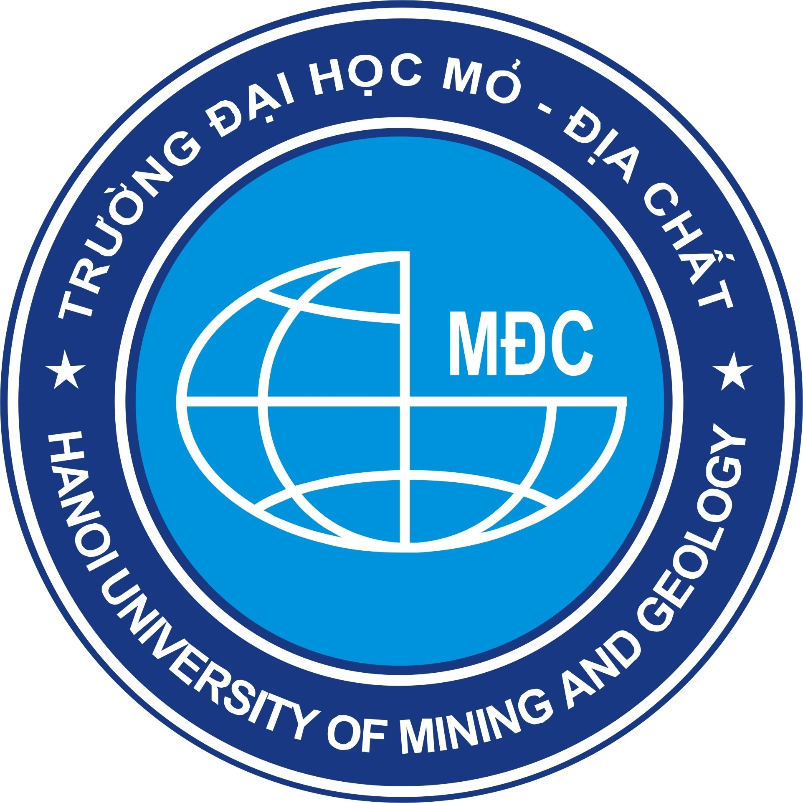
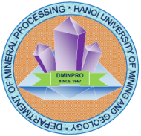
Overview of the technology of iron ore processing: A case study in the tailings from the tailing storage facility (TSF) of the Kip-Tuoc processing plant
Trường Đại học Mỏ - Địa chất
Hanoi University of Mining and Geology
Thanh-Hai Pham^{1,*}, Dzung Thi Kim Nhu¹, Luan Van Pham¹, Nhung Thi Pham¹, Toi Trung Tran¹ , Chinh Thi Vu¹, Thinh Duc Tran²
¹ Hanoi University of Mining and Geology, Hanoi, Vietnam
² Vinacomin – Minerals Holding Corporation, Hanoi, Vietnam

Slide 2
Introduction
Iron is widely used in the life and defense industry;
The most suitable separation method: gravity separation, flotation, or magnetization roasting - beneficiation.
The actual recovery degree of the entire process is approximately 80% at almost companies in Vietnam.
Iron - steel factories in Vietnam have been using a large amount of iron ore with high iron content. The amount of domestic iron ore is not enough for demand.
In order to supply the lowest production cost raw material (with suitable quality) to steel metallurgy as well as to improve the iron recovery degree from ore, the technology solution for rational recovery of iron minerals out of poor iron ores which are located at tailings pond is concerned and researched.

Slide 3
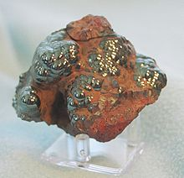
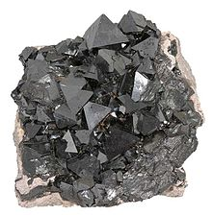
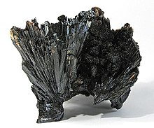
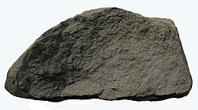
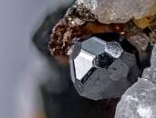
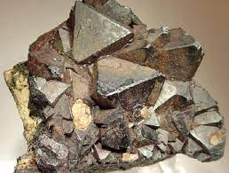
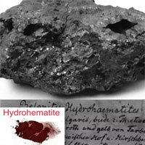
Iron ore
Hematite (Fe₂O₃)
Magnetite (Fe₃O₄)
Goethite (FeOOH)
Maghemite ((Fe³⁺[Fe³⁺_{1.67}[]_{.33}]O₄)
Kenomagnetite (Fe_{3-x}()_{x}O₄)
Quartz, kaolinite, gibbsite, minnesotaite, berthierine, chamosite, orthoclase, albite, pyrite, pyrolusite, siderite, ankerite, dolomite, stilpnomelane, chlorite
Martite
Hydrohematite

Slide 4
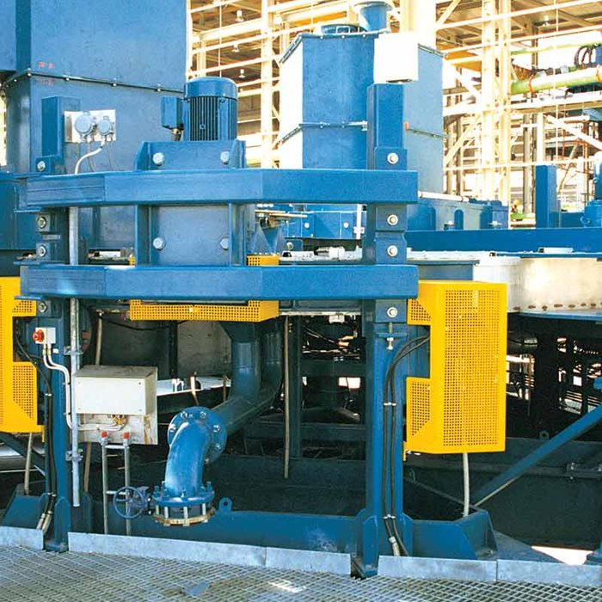
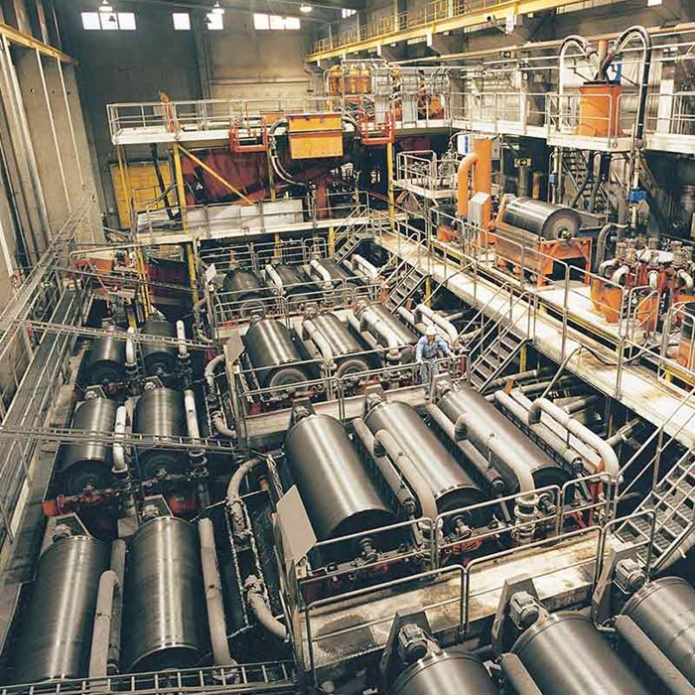
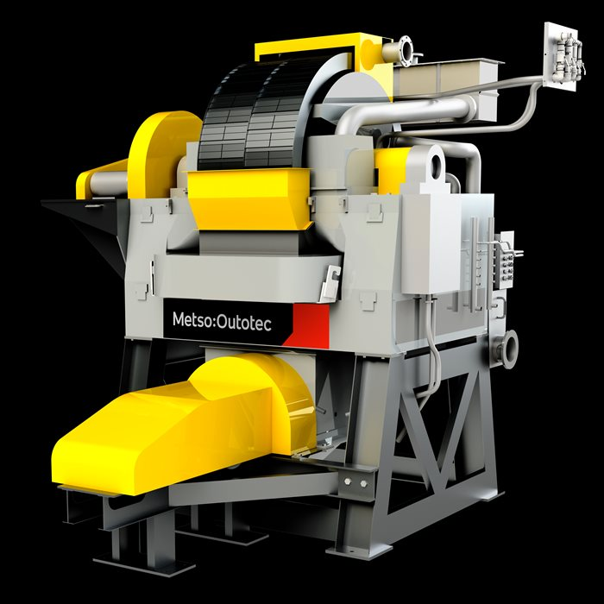
Magnetic separation
The most effective method in order to treat iron ore.
Magnetic field with the suitable intensity, gradient (based on the differences in magnetic susceptibility).
The magnetic separation recovers the strong magnetic minerals
High Gradient Magnetic Separators (HGMS)
Low Intensity Magnetic Separators (LIMS)
SLon® Vertically Pulsating High-gradient Magnetic Separator (VPHGMS)

Slide 5
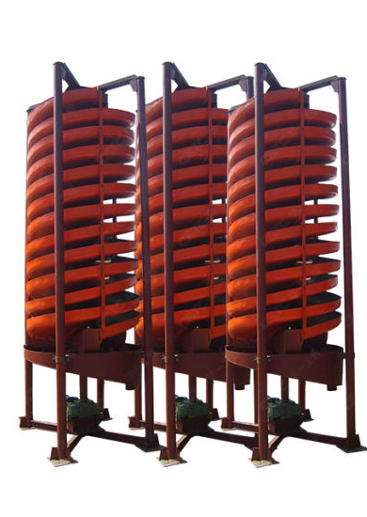
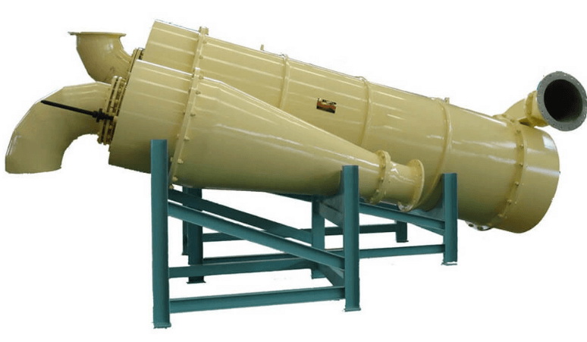
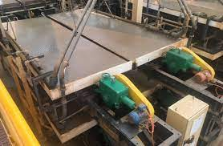
Gravity separation
This method is used mainly for hematite/goethite iron ore.
Extend processing at their source (mine) before transportation. The purpose is to supply a higher quality of iron (reduce undesirable elements like Si and Al) with a suitable particle size (6.3 – 31.5 mm)

Slide 6
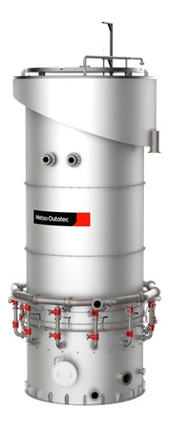
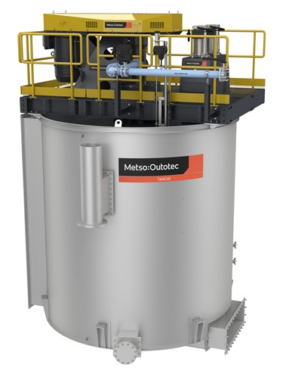
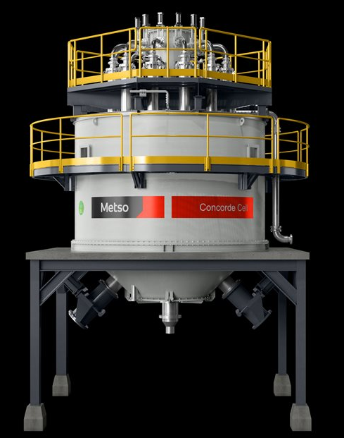
Flotation
An effective method to remove impurities from iron ore: separation of silica out of valuable minerals, aluminum removal, sulfur removal, and phosphorus removal.

Slide 7
Flotation
- For silica removal: direct flotation, reverse cationic flotation and reverse anionic flotation;
- For aluminum removal: reverse cationic flotation (the efficiency is not high- still limited);
- For phosphorus removal (an extremely un-valuable mineral because the presence of P leads to the increasing brittle of steel). In case of apatite: flotation
- Flotation is applied to separate pyrrhotite. The reverse flotation process is a good solution to float pyrrhotite from the magnetite

Slide 8
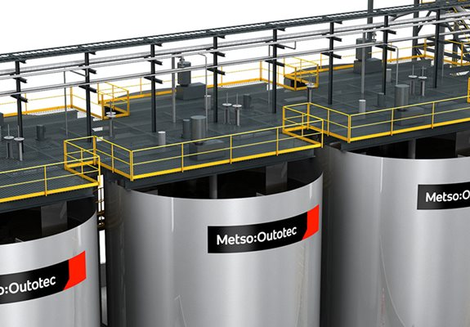
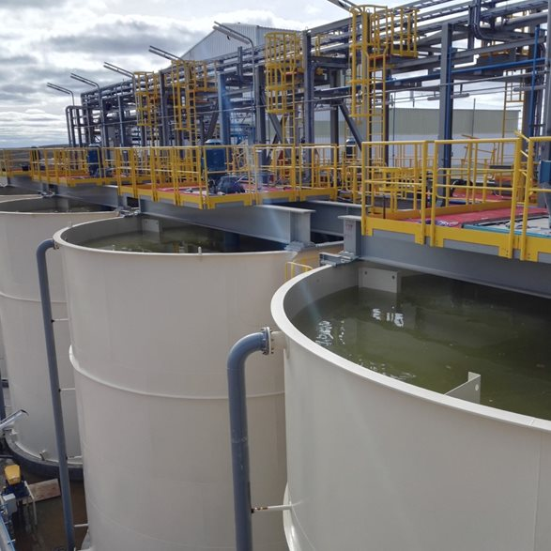
Other methods (chemical separation, thermal beneficiation, or even the application of biotechnology)
- For the chemical separation: the chemical reaction is applied to solve some elements like phosphorus, sulfide, or aluminum in iron ore

Slide 9
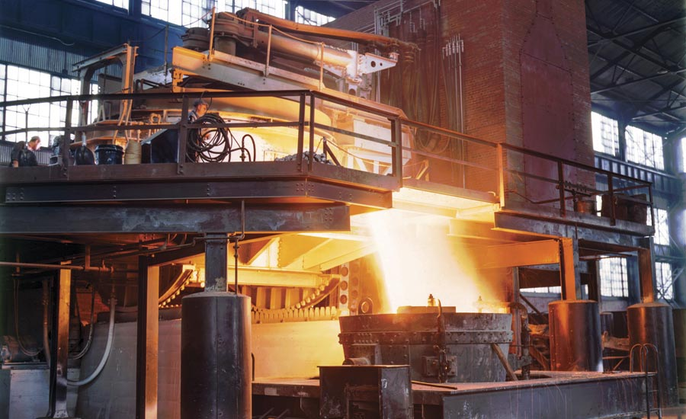
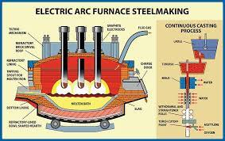
Other methods
- For thermal beneficiation: to treat the complexity of deposits. The purpose is an achievement the Fe grade at a high Fe recovery.

Slide 10
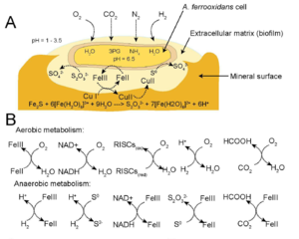
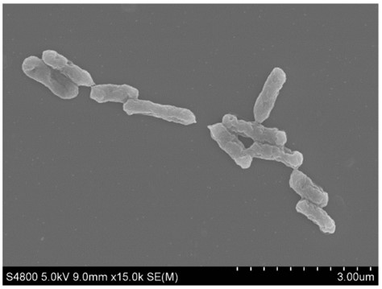
Other methods
- The biotechnology: The mechanism of this method is the microorganisms adhere and change mineral surfaces. Acidithiobacillus ferrooxidans

Slide 11
Research on iron ore beneficiation in Vietnam
The separation of iron ore limonite in the Tien Bo mine, the ROM iron ore has a content of 39.85% Fe. The beneficiation process is the combination of washing and scrubbing methods (vibration screen, mechanical classifier, and trommel screen) and reduction roasting
In the case of laterite iron ore in the Central Highlands, the 29.91% Fe ROM ore is upgraded to the concentrated ore with 46,26% Fe of content at the recovery of 69.80 with the similar technology. The difference is the reduction roasting stage is replaced by magnetizing roasting combined with a magnetic separator.

Slide 12
Research on iron ore beneficiation in Vietnam
The washing solution for coarse-grained washing, magnetic separation, and magnetizing roasting - magnetic separation for fine particle size ore of Quy Xa mine - Lao Cai
The technology to recover Fe from the tailing of Ban Luoc iron ore, Cao Bang by the magnetizing roast-magnetic separation.
Research on the selection of iron ore beneficiation technology at Ha Tinh small mines. The technological flowsheet includes the process of washing and scrubbing (the main part), following is the stage of magnetizing roasting - magnetic separation

Slide 13
Kip-Tuoc iron ore
The iron ore minerals are mainly hematite and magnetite. The main rock mineral is quartz. The accompanying mineral is feldspar.
The original ore has an average iron content of 53%.
The average content of tailings ore is up to 14.28% Fe with the estimated volume currently about 500,000 tons

Slide 14
The flowsheet of Kip Tuoc iron ore processing plant

Slide 15
The output technological criteria of the Kip Tuoc iron ore processing plant annual years

Slide 16
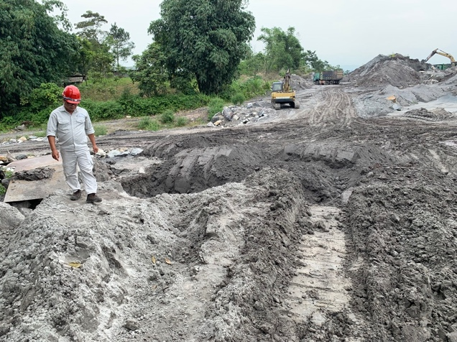
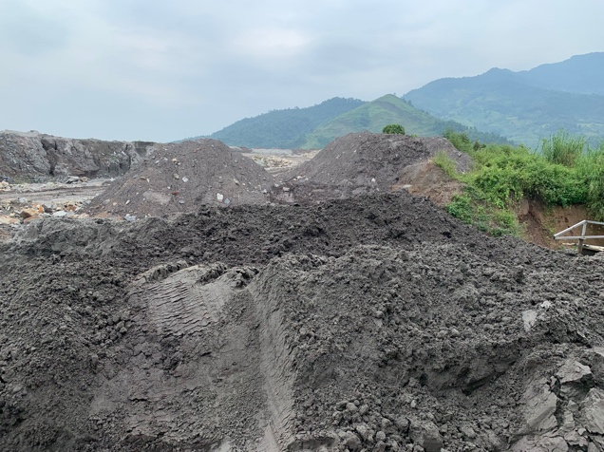
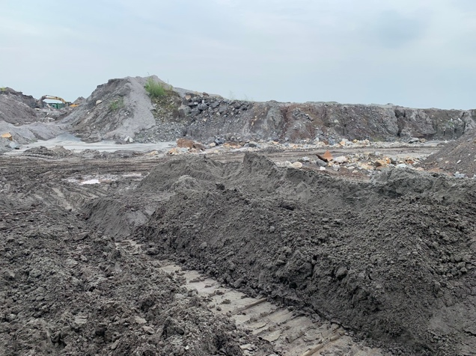
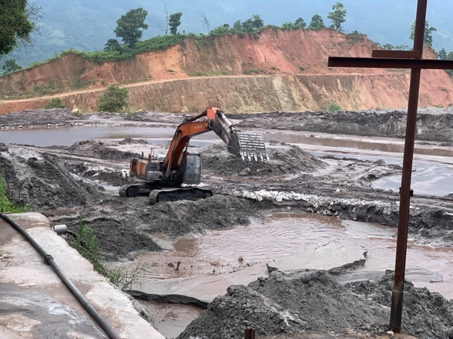
The Kip-Tuoc tailing pond

Slide 17
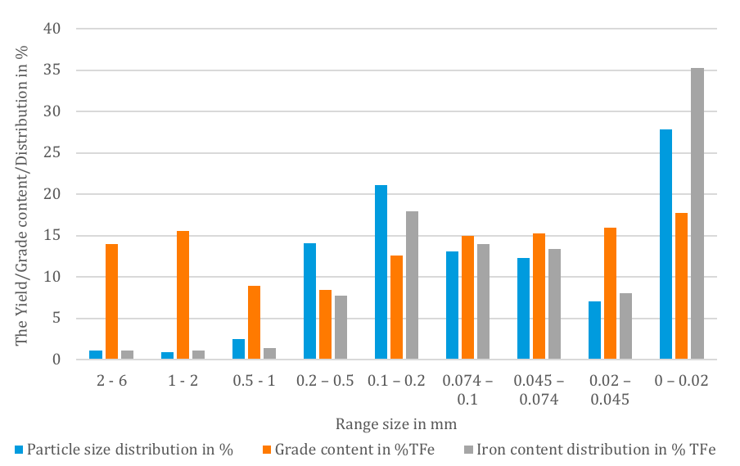
The particle size and the iron content distribution of sample

Slide 18
Chemical composition of iron ore sample
Content (%)
Al₂O₃ | TFe | SiO₂ | S | P | Others
10.28 | 14.25 | 59.46 | 0.21 | 0.11 | 15.69
Mineralogical composition of iron ore sample
Minerals | Range content (~%)
Illite (Mica) | ~ 29-31%
Clorite | ~ 4-6 %
Quarzt | ~ 29-31 %
Felspar | ~ 2-4 %
Albite | ~ 12-14 %
Hematite | ~ 15-17 %
Magnetite | ~ 2-4 %

Slide 19
SEM images of tailing ore belong the Kip Tuoc waste dump

Slide 20
The optimal test condittion
Stages | Trommel screen | Spiral | Shaking table
Optimal study condition | Rotating speed: 35 rpm; Liquid/Solid ratio: 5; Pressure washing (water): 2 atm; Feed rate: 6 m³/h. | Solid concentration: 25%; Flow rate of feed slurry: 3 m³/h. | Frequecy: 1.67 Hz; Amplitude: 10 mm; Feed rate: 0.3 kg/minute; Loading water: 0.6 liters/minute; Washing water: 1.2 liters/minute; Inclined bed surface: 1.5 degree.

Slide 21
The optimal experimental result in the trommel screen stage
Sample | Iron content %Fe | Yield (%) | Recovery (%) | Silicate (%Si)
Feed ore (Tailing ore at TSF) | 14.28 | 100.00 | 100.00 | -
Oversize product | 11.12 | 2.47 | 1.92 | -
Over 2 mm | 13.78 | 1.06 | 1.02 | -
Below 2 mm | 9.12 | 1.41 | 0.9 | -
Undersize product | 14.36 | 97.53 | 98.08 | -

Slide 22
The optimal experimental result in the spiral stage
Sample | Iron content (%Fe) | Yield (%) | Recovery (%) | Silicate (%Si)
Feed ore (Below 2 mm product) | 14.36 | 100.00 | 100.00 | -
Concentrate after spiral | 15.06 | 85.41 | 89.51 | -
Tailing after spiral | 10.33 | 14.59 | 10.49 | -

Slide 23
The optimal experimental result in the shaking table stage
Sample | Iron content (%Fe) | Yield (%) | Recovery (%) | Silicate (%Si)
Feed ore (Concentrate after spiral) | 15.06 | 100.00 | 100.00 | -
Concentrate after shaking table | 59.41 | 16.78 | 66.15 | 12.00
Tailing after shaking table | 6.13 | 83.22 | 33.85 | -

Slide 24
Proposed flowsheet for iron recovery from the taling ore of Kip Tuoc TSF

Slide 25
The quality of products after re-processing
Product | Iron content (%Fe) | Yield (%) | Recovery (%)
Oversize product after trommel screen stage | 10.7 | 2.56 | 1.92
Tailing after spiral | 10.56 | 14.58 | 10.78
Tailing after shaking table stage stage | 6.15 | 69.04 | 29.73
Total tailing | 7.03 | 86.18 | 42.43
Concentrate | 59.49 | 13.82 | 57.57
Feed ore (from TSF) | 14.28 | 100 | 100

Slide 26
Conclusion and further work
Iron ore with the popular minerals: hematite, magnetite, goethite, etc.
The tailing iron ore is the product of the previous low-efficiency process, needs reprocessing and recovering.
The main methods to upgrade the iron content as well as separate iron minerals out of the gangue: magnetic separation, gravity separation, and flotation
Case study of upgrading the tailing ore of the Kip Tuoc: the combination of the trommel screen, spiral, and shaking table. Result is the iron grade content of 59.49 % at a recovery ratio of 57.57%; the tailing: 7.03% Fe content.
The optimal parameters for each stage at the lab scale is shown. Those are the important basics for scale-up in the future as well as the reference for the iron tailing processing at other TSF in Vietnam and on the world.
Further work should be the strict control of the technology to improve the efficiency recovery.

Slide 27


