Slide 1
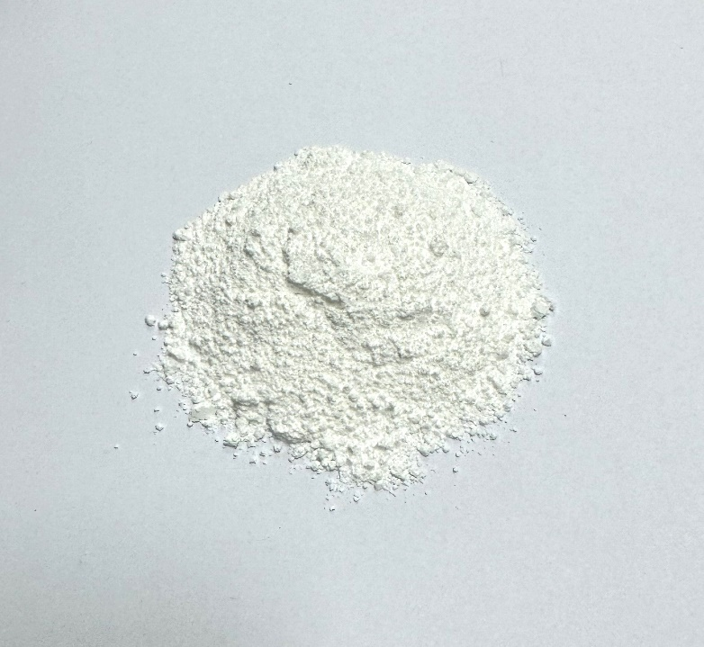
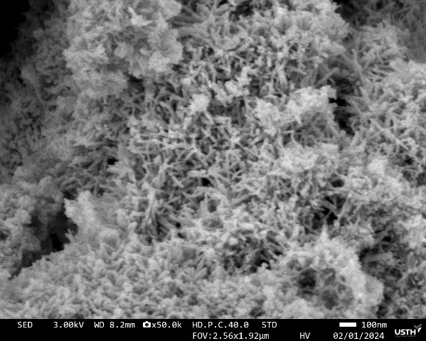
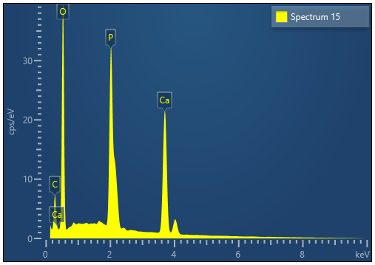
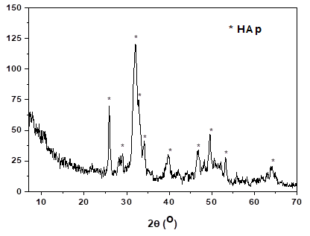
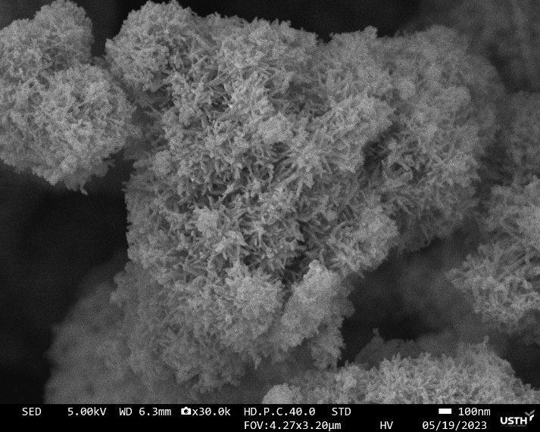
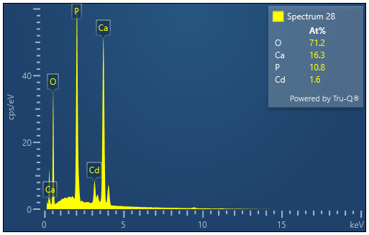
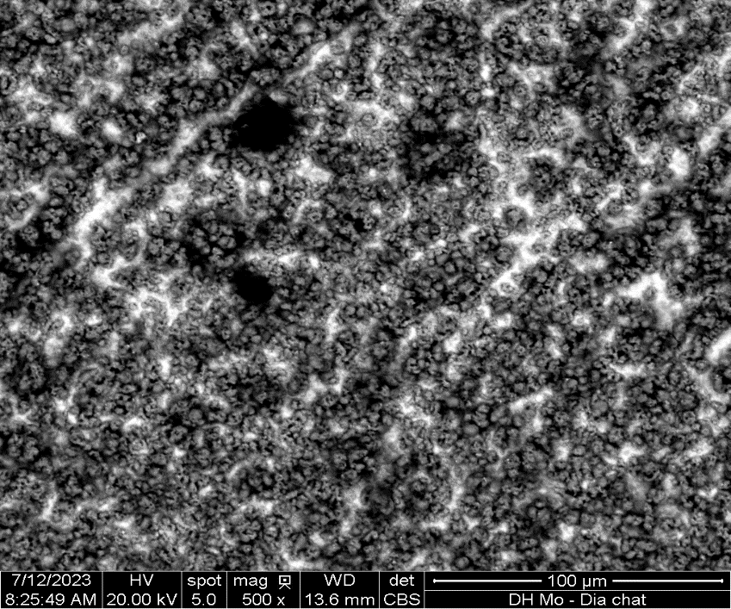
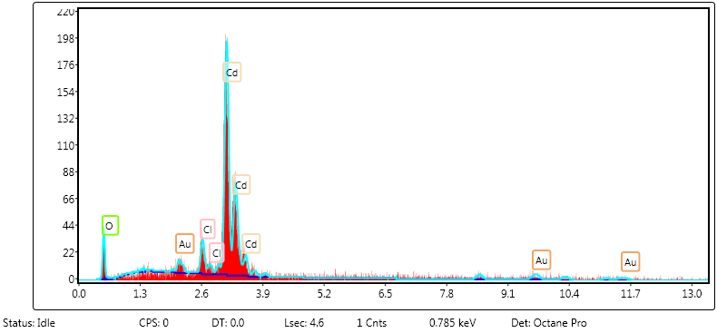
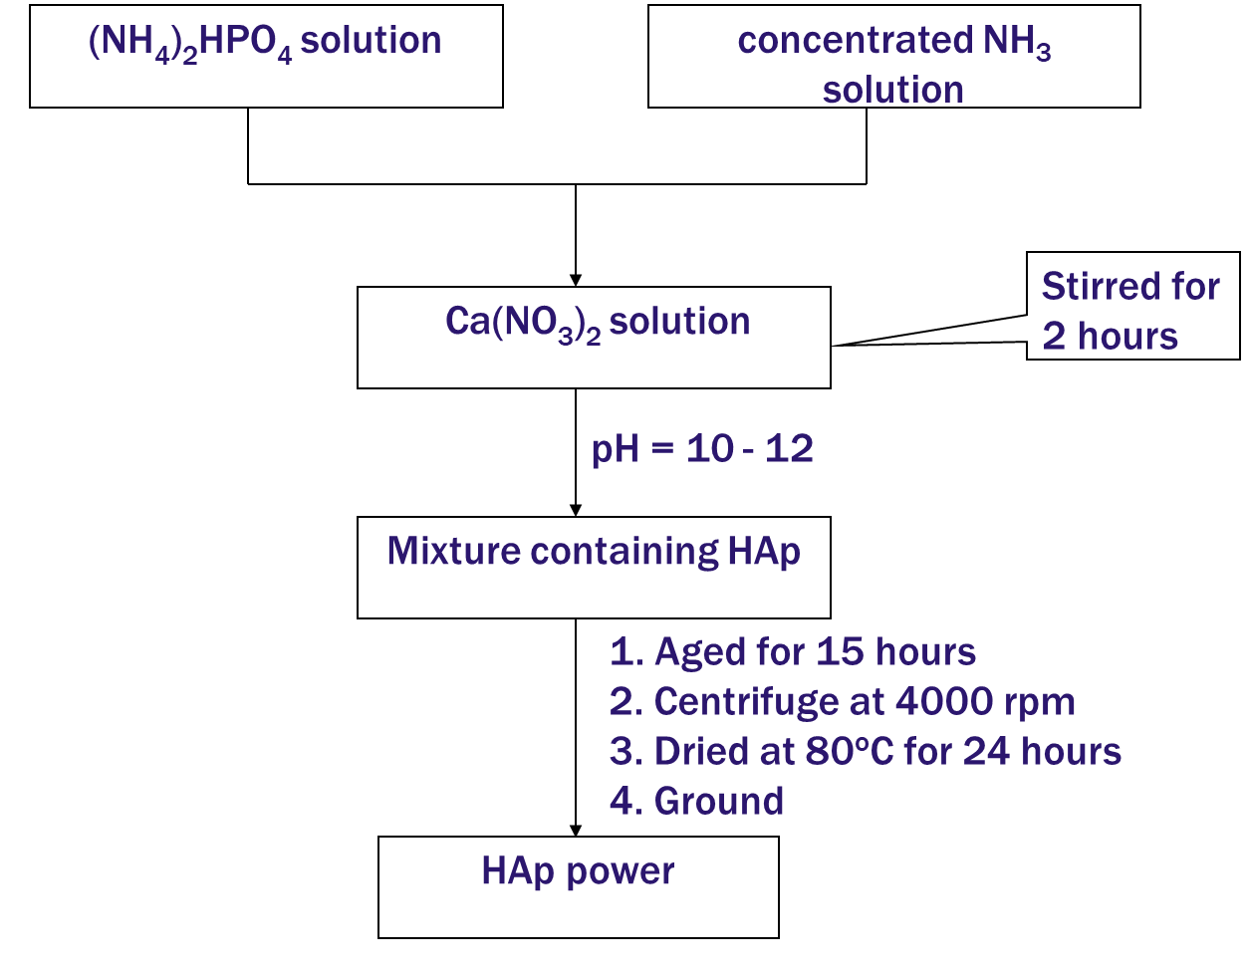




Removal of Cd²⁺ from aqueous solution using hydroxyapatite: study on adsorption-desorption and recovery of cadmium
Logo
Le Thi Duyen^{1,2,3*}, Le Thi Phuong Thao^{1,2,3}, Nguyen Viet Hung^{1,2,3}, Ha Manh Hung^{1,2}, Vo Thi Hanh^{1,2,3}, Nguyen Thi Thu Hien^{1,2,3}, Vu Kim Thu^{1,3}, Nguyen Thi Kim Thoa^{1,2}, Vu Thi Minh Hong¹, Le Thi Vinh^{1,2}, Nguyen Thu Ha¹, Đinh Thi Mai Thanh⁴, Nguyen Thi Lan Anh⁵
¹Department of Chemistry, Faculty of Basic Science, Hanoi University of Mining and Geology, No.18 Vien Street - Duc Thang Ward - Bac Tu Liem District - Hanoi, Vietnam
²BSASD Research Group, Faculty of Basic sciences, Hanoi University of Mining and Geology, Vietnam
³HiTech-CEAE Research Team, Hanoi University of Mining and Geology, Vietnam
⁴University of Science and Technology of Hanoi, Vietnam Academy of Science and Technology, 18 Hoang Quoc Viet Road, Cau Giay District, Hanoi, Vietnam
⁵Facculty of analytical engineering, Viet Tri University of Industry, No. 9 Tien Son Road – Tien Cat Ward - Viet Tri – Phu Tho, Vietnam
INTRODUCTION
Growth in the economy, industry, and technology releases more toxins into the environment, which contaminates water supplies. Because of its toxicity to aquatic creatures and the environment at low concentrations, as well as its persistence and bioaccumulation, heavy metal pollution is particularly concerning. Adsorption is a practical way to eliminate heavy metals that is simple to use, affordable to operate, and offers a wide variety of adsorbents to select from based on the adsorbent's requirements and the specific needs of treated water quality.
RESULTS AND DISCUSSION
The desorption process of Cd²⁺ from Cd²⁺ adsorbed-HAp and recovery of Cd by electrocdeposition method in reline electrolyte
The adsorption of Cd²⁺ ions by HAp powder
Ca/P = 1,629;
Ca/P/O = 10/6,139/25,426
Table 4. CV scanning parameters
WE | Au (S = 0.0201 cm²)
RE | Ag,AgCl|Cl⁻
CE | Pt
Potential step | 0,005 V
Scanning rate | 0,02 V/s
 | Cd²⁺/reline | Cd-HAp/reline
Potential range | 0.1 ÷ -0.9 (V) | -0.2 ÷ -1.2 (V)
V_{reline} | 10 mL | 10 mL
Cd²⁺ concentration | 0.005 M | -
m_{Cd-HAp} | - | 1.0 g
Calcium hydroxyapatite or hydroxyapatite (HAp), which has the formula of Ca₁₀(PO₄)₆(OH)₂ (HAp), is a material widely used in life. Because of having high activity and biocompatibility, synthetic HAp is widely used as a biomedical material in surgery of bone grafting, orthopedic, and tooth repair, as well as in the field of environmental treatment with high efficiency.
pH_{pzc} = 7,49
Fig. 1. The SEM image, EDX, XRD, FT-IR and pH_{PZC} results of fabricated HAp powder
Along with adsorption, desorption and recovery of heavy metals are also extremely important to avoid secondary pollution, to reuse useful metals from waste sources and regenerate adsorbent materials, improving economic efficiency. This report presents the results of an investigation into the feasibility of using synthetic hydroxyapatite material to adsorb Cd²⁺ ions in water. The desorption and recovery of metallic Cd were next studied with electrochemical precipitation in a reline electrolyte.
Synthetic HAp material is powdery, white, rod-shaped, and very homogeneous, with particle sizes of roughly 20 x 50 nm. The chemical composition is compatible with the molecular formula Ca₁₀(PO₄)₆(OH)₂, pHpzc = 7.49, and surface area calculated by BET of 91.42 m²/g.
The HAp material retains its rod-like structure during adsorption, although the composition contains Cd.
Fig. 6. CV curves of Cd²⁺ and Cd-HAp in reline
EXPERIMENTAL and methodology
Synthesis of HAp powder
Characteristics of materials powder by methods such as: SEM, TEM, XRD, EDX, FT-IR, BET.
Cd²⁺ ions concentration were quantified using the ICP-MS method.
Adsorption of Cd²⁺ using HAp powder
The effect impacts on adsorption process was investigated including:
- the contact time changed between 10 and 100 mins;
- the initial pH of the solution was studied between 2.7 and 7.5;
- the mass of HAL in the range of 0.01 - 0.08 g/50 mL Cd²⁺ solution;
- initial concentration of Cd²⁺ in the range of 10 - 100 mg/L.
The experiments were carried out at room temperature and kept stirring at a speed of 400 rpm.
Adsorption capacity and efficiency are calculated as follow:
Q = (C_{o} - C) x V/m; H = ((C_{o} - C)/C_{o}) x 100
Fig. 2. The SEM image and EDX results of Cd²⁺ absorbed-HAp
Fig. 7. Cathode polarization curve of Au electrode in Cd-HAp/reline at 5 mA/cm² for two hours at 60ºC
Fig. 8. The SEM image and EDX result of the surface of Au electrode after Cd-HAp electrolysis
Table 5. . The effect of factors on desorption Cd²⁺ and recovery Cd from Cd-HAp in reline
J, mA/cm² | H, % |  | m_{Cd-HAp}, g | H, % | t, hour | H, % | t, ºC | H, %
t = 5 h; m_{Cd-HAp} = 0.3 g; T = 60ºC |  |  | J = 5 mA/cm²; t = 5 h; T = 60ºC |  | J = 5 mA/cm²; m_{Cd-HAp} = 0.1 g; T = 60ºC |  | J = 5 mA/cm²; m_{Cd-HAp} = 0.1 g; t = 8 h
1 |  | 49.83 | 0.1 | 86.67 | 2 | 75.36 | 50 | 86.35
2 |  | 58.79 | 0.2 | 78.62 | 3 | 78.62 | 60 | 94.12
3 |  | 65.82 | 0.3 | 72.69 | 4 | 83.07 | 70 | 94.79
5 |  | 72.69 |  |  | 5 | 86.67
7.5 |  | 73.32 |  |  | 6 | 89.98
 |  |  |  |  | 8 | 94.12
 |  |  |  |  | 10 | 96.40
Fig. 3. The effect of contact time (a), pH (b), mass of HAp (c) and Cd²⁺ initial concentration on the HAp’s adsorption of Cd²⁺
The appropriate adsorption conditions: 0.05 g HAp/50 mL Cd²⁺ solution of 50 mg/L, contact time of 60 minutes at natural pH 6.5, room temperature (25ºC).
CONCLUSIONS
Hydroxyapatite obtained from chemical synthesis method, was used to remove Cd²⁺ ions from aqueous solution and investigate the effects of different factors on the adsorption capacity and efficiency of HAp for Cd²⁺ ions. The optimal conditions were determined such as 0.05 g mass of HAp per 50 mL of solution, initial Cd²⁺ concentration of 50 mg/L, contact time of 60 min, pH 6.5, and room temperature (25°C). Under these conditions, the adsorption efficiency and capacity obtained 94.994% and 47.497 mg/g, respectively. The results of adsorption isotherms showed that adsorption of Cd²⁺ ions using HAp powder followed Langmuir isothermal model with the maximum mono layer adsorption capacity of 84.034 mg/g. The experiment data of adsorption kinetics confirmed that Cd²⁺ adsorption process followed the pseudo-second-order law with the correlation coefficient (R²) of 0.9998. Desorption experiments were conducted with a deep eutectic solvent based on choline chloride and urea (reline) by electrochemical method. The results showed that 96.40% of Cd metal could be recovered from 0.1 g Cd-HAp by electrodeposition after 10 h, using a cathode current density of 5 mA/cm² at 60°C. The HAp material was successfully regenerated after the desorption process.
Fig. 4. Langmuir (a) and Freundlich (b) isotherm plots for the adsorption of Cd²⁺ onto HAp
Table 2. Adsorption isotherm parameters
Desorption of Cd²⁺ ions and recovery of metallic Cd by electrochemical precipitation
Deep eutectic solvent (DES) of reline was made from choline chloride (ChCl) and urea (U). The two solid chemicals were mixed with a molar ratio of 1:2 and stirred at 60ºC for 3 h until a colorless and homogeneous liquid was obtained.
Langmuir |  |  | Freundlich
Q_{m} | K_{L} | R² | n | K_{F} | R²
84.034 | 0.8151 | 0.9957 | 3.3478 | 35.0649 | 0.9643
Table 1. Electrolysis parameters
WE | Au (S = 1 cm²)
RE | Ag,AgCl|Cl⁻
CE | Pt grid
V_{reline} | 5 mL
Fig. 5. The description of the experimental data according to pseudo-first-order kinetic equantion (a) and pseudo-second-order kinetic equantion (b) for adsorption of Cd²⁺ onto HAp
CONTACT
Address: Hanoi University of Mining and Geology, Hanoi, Vietnam
Email: lethiduyen@humg.edu.vn
Mobilephone: 0978 406 866
Table 3. Adsorption kinetic parameters
Pseudo-first-order kinetic equation |  |  | Pseudo-second-order kinetic equation |  |  | Q_{e,exp}
Q_{e} | k₁ | R² | Q_{e} | k₂ | R²
17.059 | 0.05710 | 0.9045 | 71.942 | 0.00776 | 0.9998 | 70.648
REFERENCES
1. Ali, H., et al., Journal of Chemistry 2019 (2019) 1. 10.1155/2019/6730305
2. Wang, Z., et al., Environ Pollut 331 (2023) 121845. 10.1016/j.envpol.2023.121845
3. Praipipat, P., et al., Arabian Journal of Chemistry 16 (2023). 10.1016/j.arabjc.2023.104640
4. Pai, S., et al., Journal of Water Process Engineering 38 (2020) 101574. 10.1016/j.jwpe.2020.101574
THE 12nd VIETNAM NATIONAL CONFERENCE ON CATALYSIS AND ADSORPTION
The 3rd Vietnam - Taiwan Joint Symposium on Catalysis
Ba Ria- Vung Tau, May 23-25, 2024
Sponsor
by
Organized by

